Slide 1
CALIFORNIA DEPARTMENT OF INSURANCE
Availability of Fire Insurance for
Eastern Sierra Residents
Durriya Syed
Northern CA Outreach Analyst

Slide 2
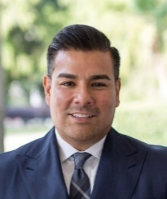
ROLE OF INSURANCE COMMISSIONER RICARDO LARA
Protect consumers
Maintain insurer solvency
Set standards for agents and broker licensing
Perform market conduct reviews of insurance companies
Resolve consumer complaints
Investigate and prosecute insurance fraud
Cannot require or compel insurance companies to sell insurance

Slide 3
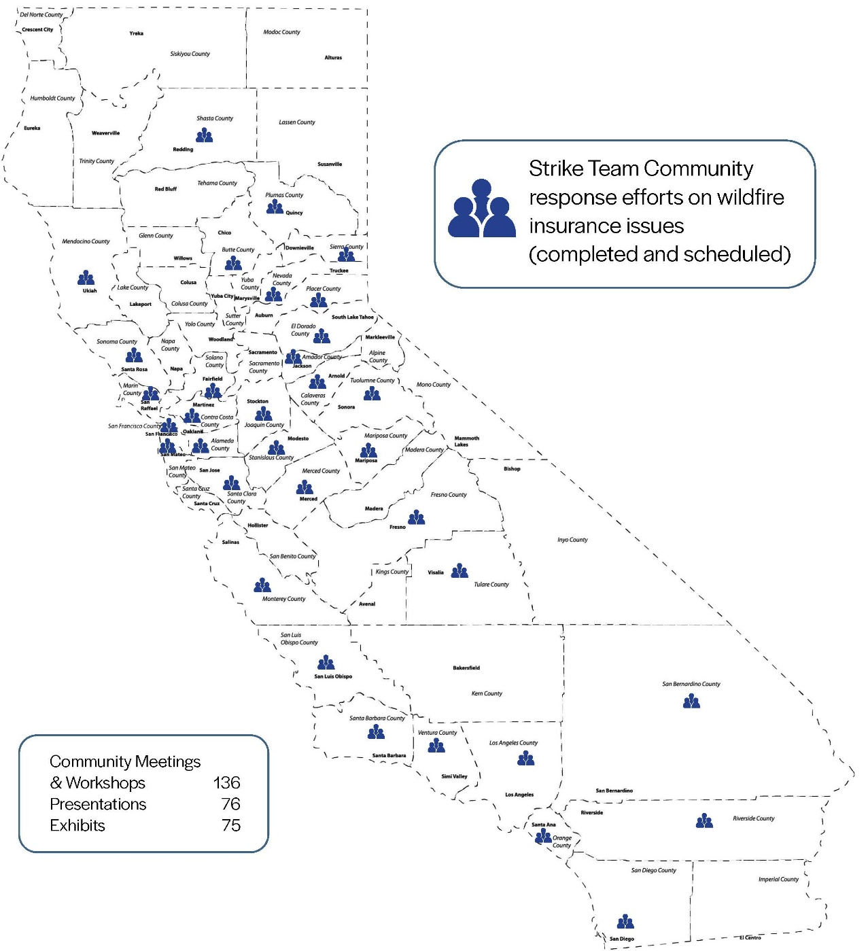
What CDI Has Done
Met with more than 25,000 people to hear wildfire and insurance concerns through
60 virtual events in
40 counties
Since 2019

Slide 4
Progress Report
Removed barriers to allow wildfire survivors to receive critical insurance benefits
Coverage for evacuation expenses
Extensions to additional living expenses
Created disclosures and coverage to meet upgraded building codes
One year moratorium from non-renewals (More than 4 million policyholders protected)
Increased non-renewal notice from 45 to 75 days

Slide 5
Improving the FAIR Plan

Slide 6
Launched in January 2022, Safer from Wildfires is an interagency partnership between Insurance Commissioner Ricardo Lara and the state’s emergency response and readiness agencies to protect lives, homes, and businesses by reducing wildfire risk.

Slide 7
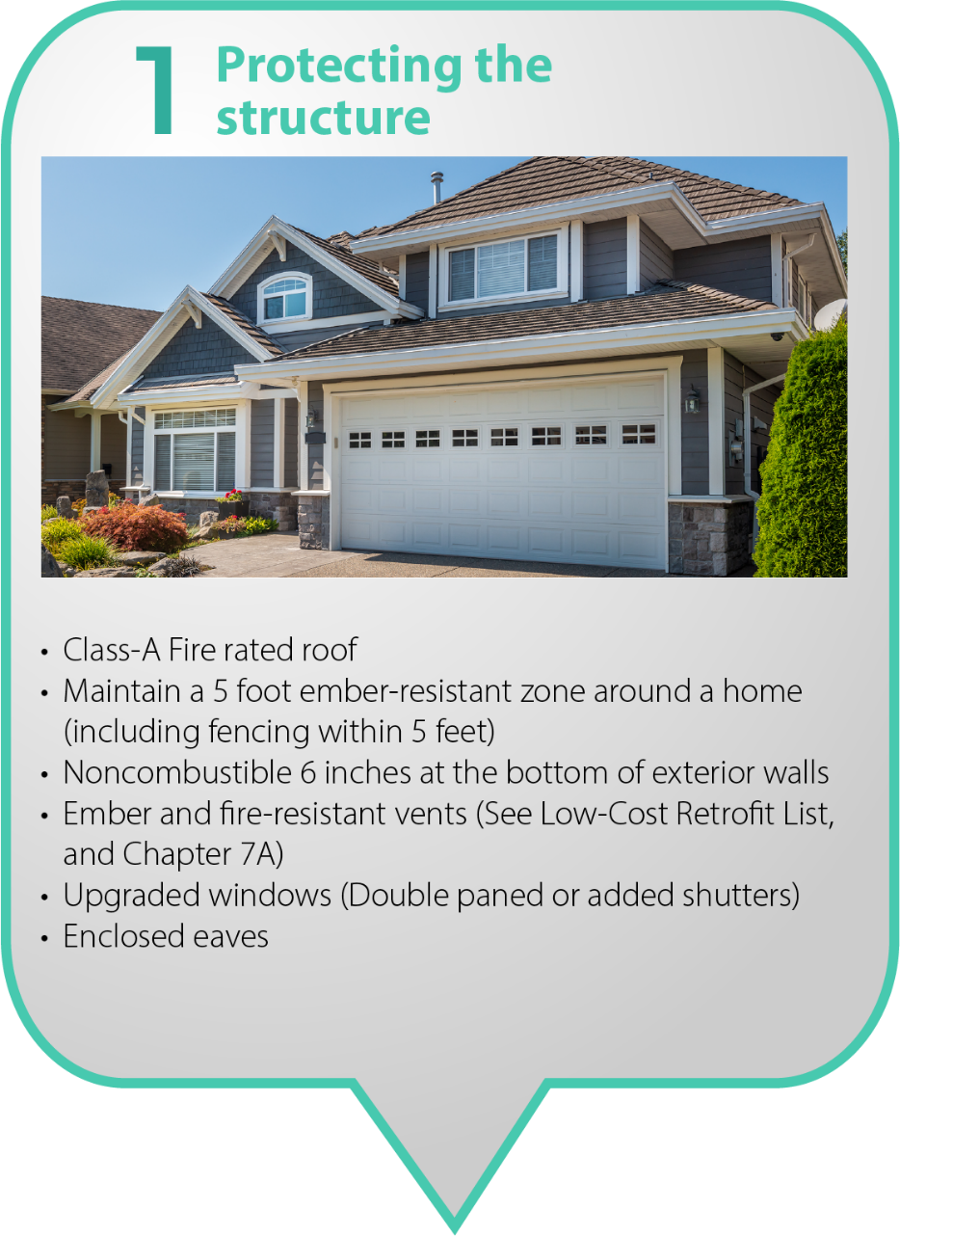

Slide 8
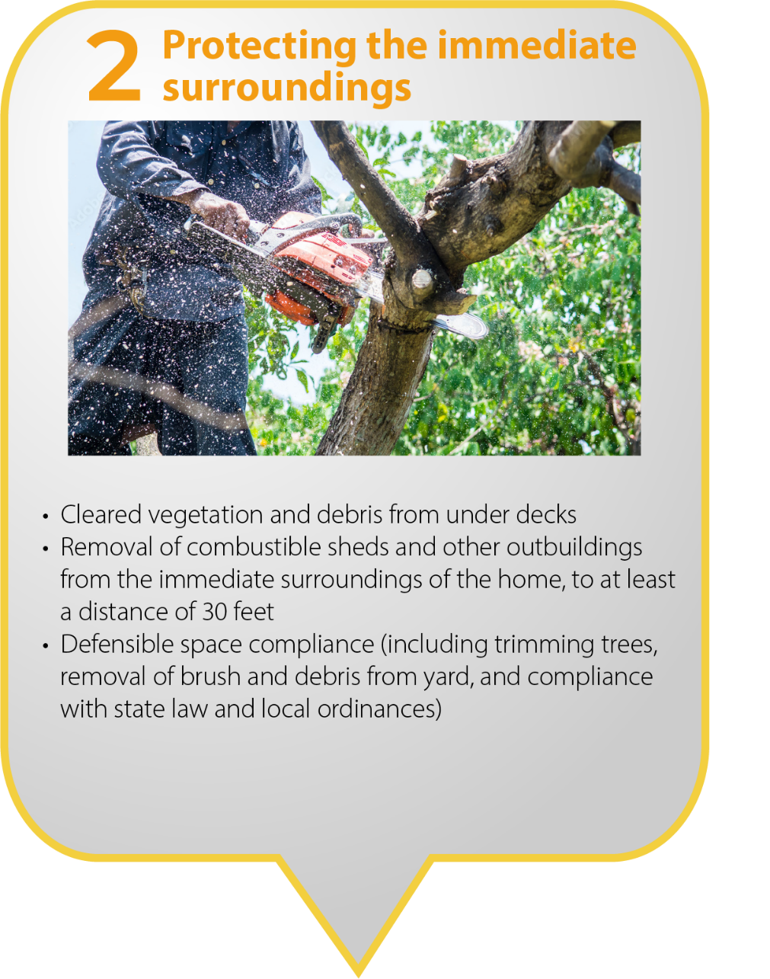

Slide 10
Regulations to lower costs and
increase transparency
The regulation is now state law and in the California Code of Regulations.
Requires insurance companies to factor consumers’ and businesses’ wildfire safety actions into their pricing
Provides consumers with transparency about their “wildfire risk score” that insurance companies assign to properties
Gives consumers the right to appeal their risk determination

Slide 11
It Is Working!
The number of homeowners non-renewed by insurance companies fell by 10 percent statewide in 2020 compared to the previous year — a decrease of 22,870 policies.
Premium discounts now available to 2 out of every 5 consumers, with up to 20 percent discounts for wildfire-hardened homes – 6x increase since 2019

Slide 12
Getting Prepared - Be Proactive
Do a home insurance tune-up – review your policy
Do a Home Inventory and Pack a “Go Bag”
Use the Department’s online tools at insurance.ca.gov

Slide 13
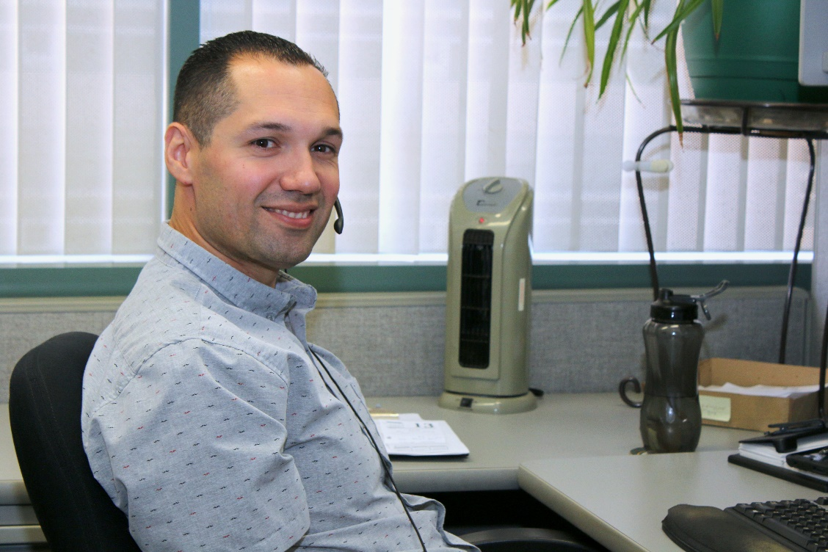
QUESTIONS?
1-800-927-4357
insurance.ca.gov

