Slide 1
Predictive Services Regional Conditions
Predictive Service
May 02, 2022

Slide 2
Overview-
December held the last substantial rain that California has seen
Snowpack for the State is 38% of average with the Sierra's at 4%
Temperatures continue to break maximum records
NOPS indices are breaking records and generally trending 1-2 months early
SOPS indices are generally above average but not record breaking

Slide 3
California Drought

Slide 4
Fuels Moistures herbaceous

Slide 5
Live Fuel Moistures - SOPS
* Average for Geographic Area for shrub live fuel moistures

Slide 6
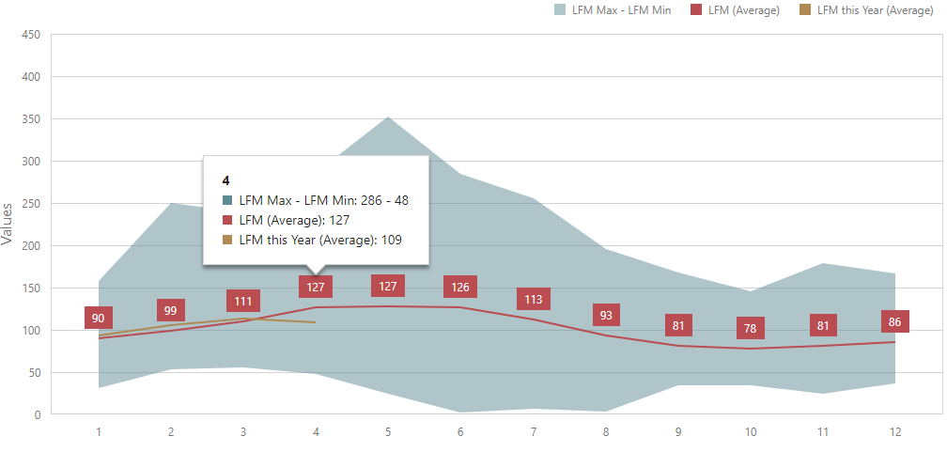
Live Fuel Moistures – NOPS
* Average for Geographic Area for shrub live fuel moistures

Slide 7
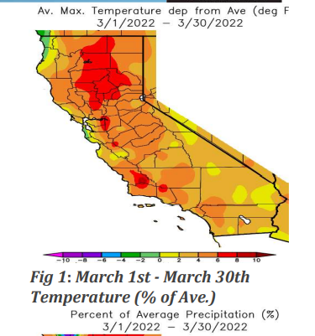
Statewide -Temp

Slide 8
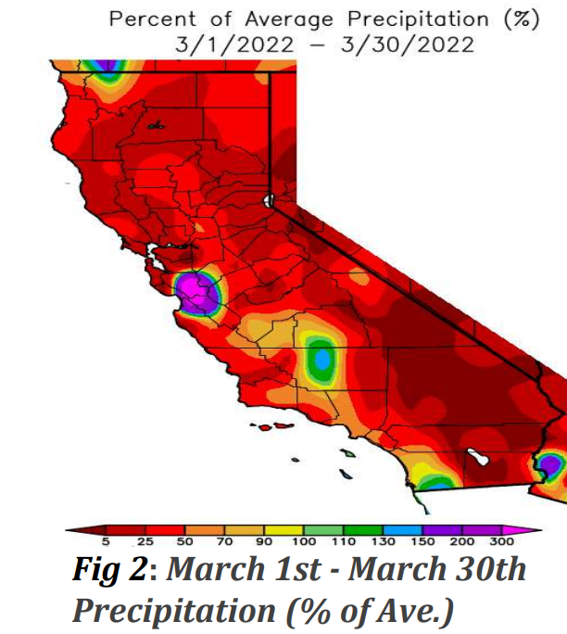
Statewide -Precip

Slide 9
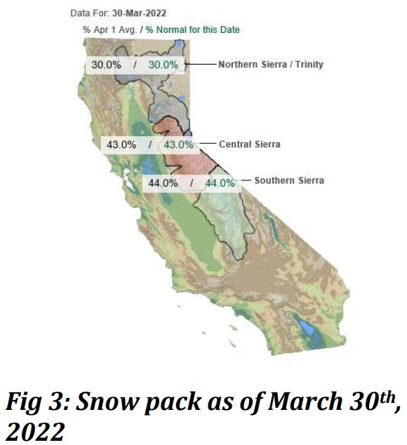
Statewide - Snowpack

Slide 10
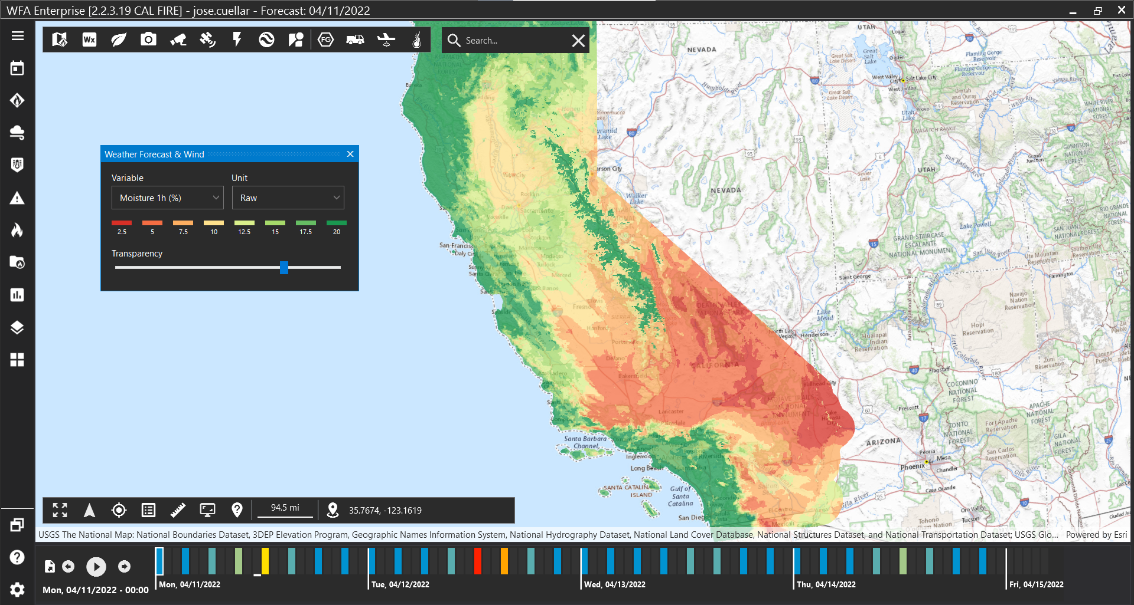
Fuels Moistures 1 Hour Fuels

Slide 11
Fuels Moistures 10 Hour Fuels

Slide 12
Fuels Moistures 100 Hour Fuels

Slide 13
Weather Discussion – North Ops
The weather pattern was more unsettled during March compared to January and February, but below normal precipitation remained across most of the area. Average temperatures were generally above normal excluding some of the near coastal areas. The outlook for the North Ops region is for near to above normal temperatures and near to below normal precipitation from April through July. The weather pattern during April appears to be like what occurred in March but a tad drier overall. May and June look to be warmer and drier. Critically dry wind events, whether they be westerly or northerly, should occur with normal frequency from April to June. La Niña influences should remain through the spring and could possibly extend into the summer although confidence is less for the summer extension.

Slide 14
Fuels Discussion - North Ops
A variety of fuel conditions and flammability exists across northern California, but dead fuels are generally drier than normal. The 1000-hour dead fuel moisture indicates an overall drying trend since January. The woody shrubs are in a mixed flammability state, due to long term drought impacts and an unusual early start to the main growing season. The woody shrubs have greened up across the lower elevations and are in greening up across some, if not most, mid elevations. Abundant late October and December moisture promoted widespread herbaceous fuel growth up to 4000-4500 feet. Curing was visible from February through March across the lowest elevations due to the extended dry periods. Herbaceous fuel loading is still a bit unknown, but it is likely to be near to below normal most areas. The snow cover and water content lowered from 60-65% at the beginning of March to 30-40% at the end of the month. This is the lowest it has been, for this time of year, in the last 5 years.

Slide 15
North Ops.
April - July 2022 North Ops Highlights
Weather outlook for April to July is near to above normal temperatures and near to below normal precipitation.
Growing season started early therefore earlier flammable fuel alignments likely.
Fuel conditions vary based on elevations with flammability increasing May through July
Significant Fire Potential is Normal for all areas in April, then increasing to Above Normal for May and June across low and mid elevations. Then in July all elevations will be Above Normal for significant fire potential.

Slide 16
Weather Discussion – South Ops.
Weather Discussion High pressure remained just off the California Coast most of March, just like it did in January and February. The area of high pressure caused temperatures to be above normal most of the month. However, a few troughs brought brief periods of below normal temperatures. Overall, temperatures were above normal in March, with the greatest anomalies over the coastal areas. Our first significant storm since the end of December occurred at the end of the month. Most locations away from the deserts received between a half inch and 2 inches of rainfall with this storm. The other troughs came out of the north and brought scattered showers with light precipitation totals on a few days. Most of the area received below normal precipitation in March. However, near to a little above normal precipitation occurred over the southern part of the San Joaquin Valley and southern San Diego County. The snowpack in the Sierra is now melting rapidly and it is currently between 40% and 50% of normal. Light to moderate Santa Ana wind events occurred throughout the month. There were brief periods of strong westerly winds over the mountains and deserts ahead of each trough.

Slide 17
Fuels Discussion – South Ops.
Fuels Discussion The drought is getting worse since precipitation has been well below normal since January . Most of the San Joaquin Valley as well as the deserts bordering Nevada and Arizona are now in extreme drought. The rest of Central and Southern California is mainly in severe drought. The only exception is that moderate drought continues from the mountains westward south of Los Angeles County. Both the 1000-hr and 100-hr dead fuel moisture remained below normal and broke record low values most of the month. The curing phase of the fine fuels across the lower elevations has started to begin. The live fuel moisture is now starting to decrease, but it remains well above normal. Usually, the live fuel moisture peaks in early to mid-April so we are around a month ahead of schedule.

Slide 18
South Ops.
April 2022 - July 2022 South Ops Highlights
Temperatures will likely be above normal through July.
Rainfall will likely be below normal through June.
The amount of Santa Ana wind events will likely be near to a little above normal in April and May.
The marine layer will likely be shallower and not penetrate as far inland as normal in May and June.
Monsoon shower and thunderstorm activity will likely be near to above normal in

Slide 19
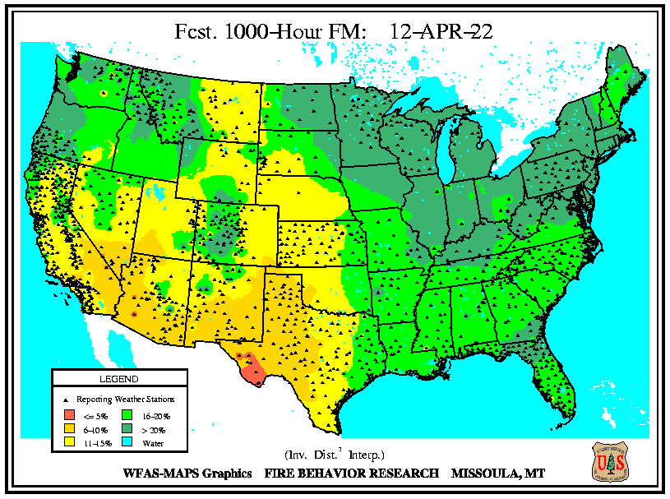
Indices
Dead fuel moistures are low across a majority of the state

Slide 20
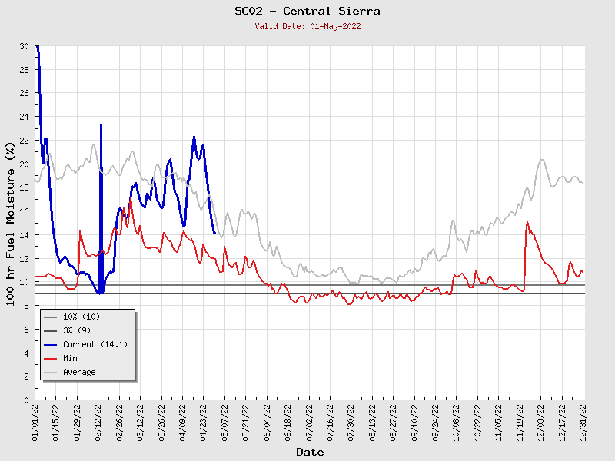

Slide 21
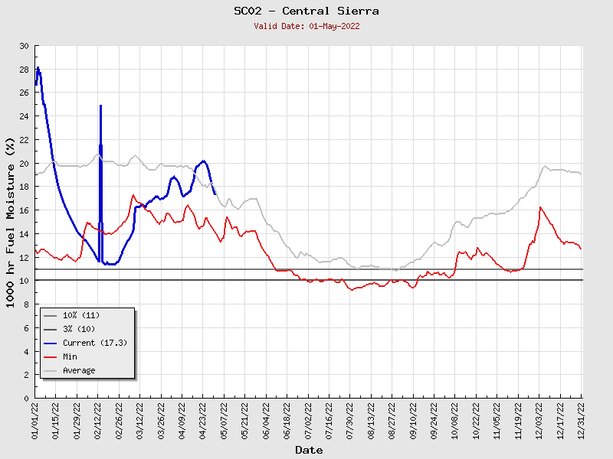

Slide 22
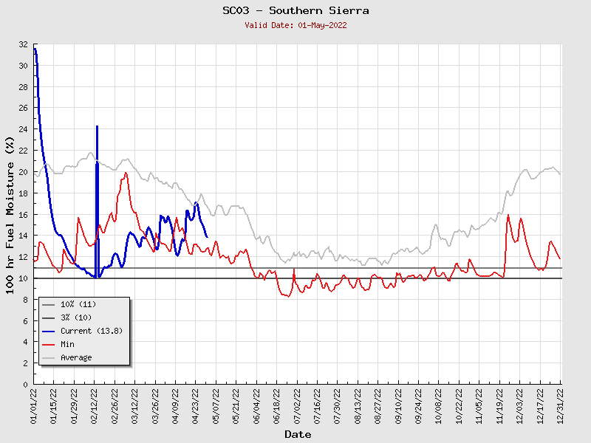

Slide 23
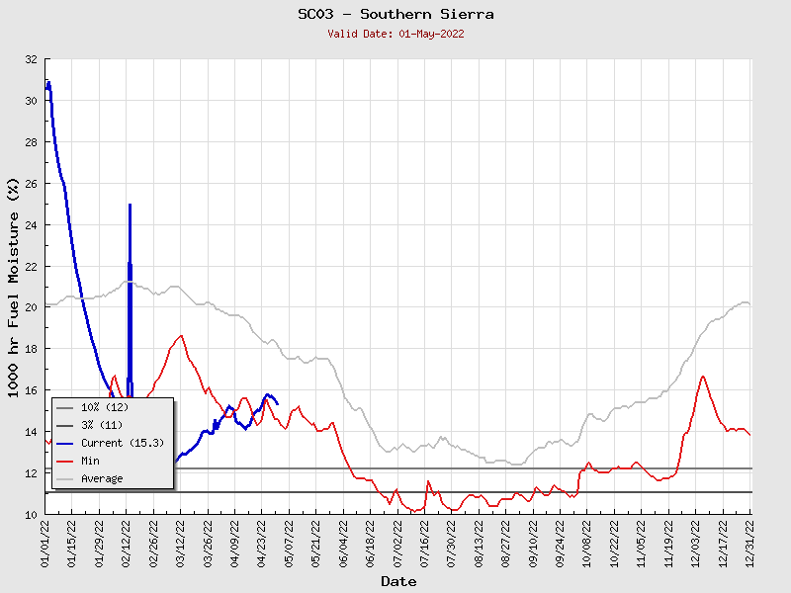

Slide 24
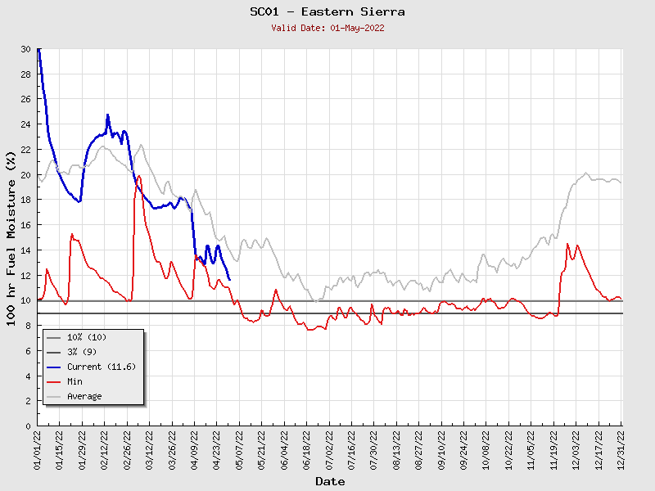

Slide 25
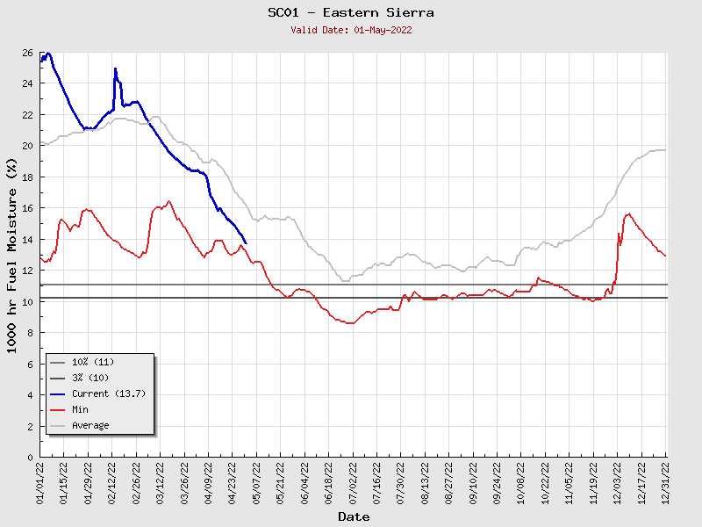

Slide 26
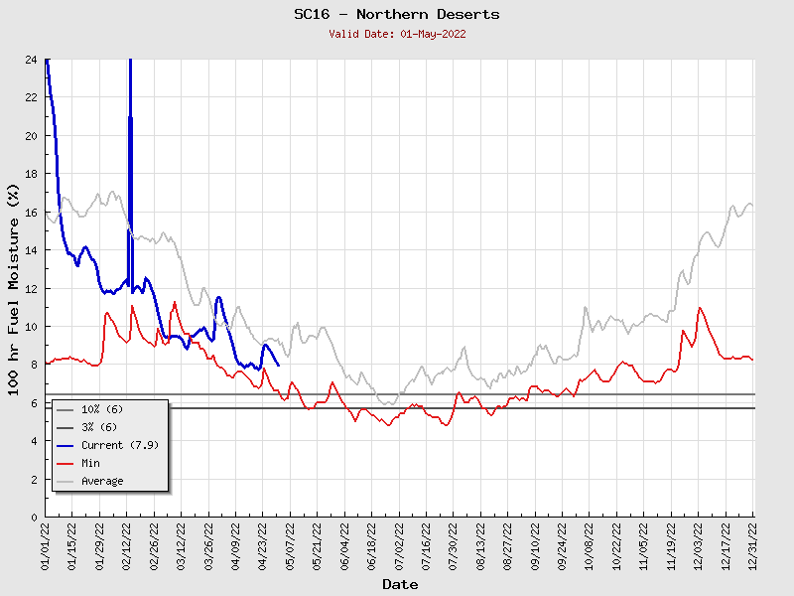

Slide 27
