Slide 1
Industrial Hemp
By April Sall, Mono County Community Development
4/29/20

Slide 2
Overview
Background on Industrial Hemp (IH)
Registration and Regulation
Testing and Sampling
Abatement and Enforcement
Industrial Hemp Program Consideration and Options
County Comparisons
Policy Discussion
Poll Questions

Slide 3
Background: Industrial Hemp
2018: The Agriculture Improvement Act of 2018 (2018 Farm Bill), paved the way for industrial hemp to be grown by citizens and commercially in US.
2017: The California Industrial Hemp Farming Act (Senate Bill 566)
Senate Bill 1409 was approved by the Governor on September 30, 2018 and went into effect on January 1, 2019.
2019: Many of the regulations were in flux, therefor several counties including Mono, established a moratorium on cultivation: expires Nov 2020
Notes:
The Agriculture Improvement Act of 2018 (2018 Farm Bill) , effective January 1, 2019, removed hemp from Schedule I of the federal Controlled Substances Act. Thus, hemp is no longer federally regulated as a controlled substance.
The Agriculture Improvement Act of 2018 (2018 Farm Bill), paved the way for industrial hemp to be grown by citizens and commercially not just by “established agricultural research institutions” (EARIs) but by citizens seeking to enter the industrial hemp industry.
Established framework for important regulations at the State level that must be put in place before cultivation of industrial hemp (IH)
Although the Farm Bill allows industrial hemp production, there are important regulations at the State level that needed to be put in place before an individual or company (other than an EARI) could legally grow industrial hemp.
The California Industrial Hemp Farming Act (Senate Bill 566, Chapter 398, Statutes of 2013) authorized the commercial production of industrial hemp and provided for the registration of growers.
Also established general requirements for:
Registration
excluded industrial hemp from the definition of marijuana
Sampling and Testing industrial, set the maximum tetrahydrocannabinol (THC) level for hemp at .3%
The bill also established general requirements for registration, required testing and sampling industrial hemp before it could be harvested, excluded industrial hemp from the definition of marijuana, set the maximum tetrahydrocannabinol (THC) level for hemp at .3%, restricted growing patterns, the purposes (grain and fiber) for which hemp could be grown and excluded EARIs from THC limitations and county registration. This law was inoperative unless federal laws allowed industrial hemp production. The passage of Proposition 64, November 2016 removed the inoperative statement making the Act effective January 1, 2017. (Ref No. 3, 4)
The State created emergency regulations for the program in June 2019 and codified and adopted several of those section in Senate Bill 1409.
Also the State created first emergency regulations for sampling, testing, abatement etc. Those regs were readopted under emergency rulemaking and are still in need of final adoption and codification via state legislation.
Senate Bill 1409 was approved by the Governor on September 30, 2018 and went into effect on January 1, 2019.
For instance, County registration with the agricultural commissioner to grow industrial hemp is allowed as of January 1, 2019 but the regulations laying out the specifics were not yet approved
Because of the back and forth laws between the feds and the state as well as issues arising with the first industrial hemp operations and what constitueted an Establish Agricultural Research Institution, and the lag time in the development of permanent regulations and requirements.
Many of the regulations were in flux and
therefore several counties including Mono County, decided to adopt an emergency Moratorium on IH cultivation until such State regs could de developed and adopted.
Absent completed regulations, some counties have chosen to place a temporary emergency moratorium on industrial hemp production until reasonable regulations are in place. Among their concerns, counties sight the definition of an EARI is not clearly defined and could allow industrial hemp growers to claim exemption from regulations using educational institutions with questionable credentials.
In 2019, SB153 codified many of the foundational sections of regs into law (see below under Background on CA). Recently, the State of CA accepted some of the remaining sections (4900) to the Title 3 of the CA Code of regs for Industrial Hemp permanently. They have also added new sections related to registration process and background checks.
CA also readopted Sections 4940-4946 and 4050and 4050.1 under emergency rulemaking (first in December and then again on March 25, 2020). These later sections covering THC Sampling, Testing and any enforcement actions are the regs still under emergency rulemaking, and also in a pending CA State bill (SBXXX).
CDFA has not yet submitted a proposed state regulatory plan to the U.S. Department of Agriculture (USDA) for review and approval but is in the process of preparing a plan for submission.
“Approved state plan” means a state plan for California that is approved pursuant to Section 297B of the federal Agricultural Marketing Act of 1946 (added by Section 10113 of the federal Agriculture Improvement Act of 2018 (Public Law 115-334)) and in effect.

Slide 4
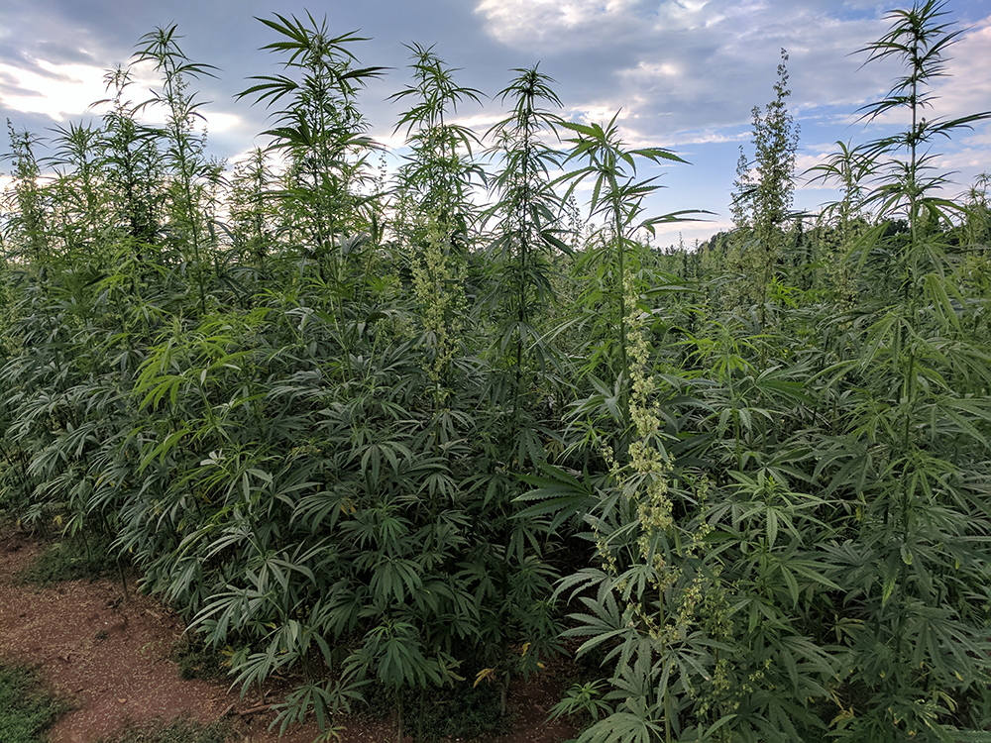
Notes:
Industrial hemp looks the same to the observer as commercial cannabis

Slide 5
CA Registration and Regulation
CA Registration: Mandatory through the Ag. Commissioners office (baseline requirement)
  Valid for one year, after which the registrant shall renew the registration and pay an accompanying renewal fee of $900 (Section 81005).
State mandated requirements: (CA)
  Application with basic applicant and project information and $900 fee
  Approved cultivar
  Testing and Sampling Plan
  Abatement Plan

Slide 6
CA: Sampling and Testing
Concern is to assure that Industrial Hemp cultivated is 0.3% > THC content, therefore all operations are subject to random sampling and testing per the county’s Ag Commissioner
The applicant must submit a Sampling and Testing Plan and is subject to the protocols and requirements of CA at a minimum.
Samples must be tasting by the Ag Commissioners office or an approved sampling and testing laboratory
Samples must be taken within 30 days of harvest

Slide 7
Abatement and Enforcement
If the laboratory test report indicates a 0.3-1% concentration of THC = the registrant shall submit additional samples for testing of the industrial hemp grown.
If the Lab report is 1%<: A registrant shall destroy the industrial hemp grown upon receipt of a first laboratory test report indicating a 1% < concentration of THC
OR
a second laboratory test report indicating a percentage concentration of THC that exceeds 0.3 percent but is less than 1 percent. If the percentage concentration of THC exceeds 1 percent, the destruction shall begin within 48 hours, and be completed within seven days, after receipt of the laboratory test report. If the percentage concentration of THC in the second laboratory test report exceeds 0.3 percent but is less than 1 percent, the destruction shall take place as soon as practicable, but no later than 45 days after receipt of the second test report.
Notes:
Several different abatement and enforcement actions if a crop of hemp’s random sampling tests >0.3 % THC

Slide 8
Industrial Hemp for Mono County: Program options
Ban IH cultivation and processing altogether in Mono County
Allow IH cultivation under the State of Ca regulations
Allow IH under a Pilot Program
Allow IH under State Regulations and Mono County requirements (for example: w/ a Use Permit from the Community Development Department (CDD))

Slide 9
Industrial Hemp: County Comparisons
Several counties are still under moratorium and have not yet decided (Calaveras, Mariposa, Mendocino, Yolo)
Ban IH cultivation and processing altogether:
  Examples: Napa, Sacramento
Allow IH cultivation under the State of Ca regulations:
  Examples: Butte, Plumas, Santa Barbara, Ventura
Allow IH under a Pilot Program:
  Examples: Monterey, Stanislaus, Mendocino (trying to get BOS approval)
Allow IH under State Regulations and additional County requirements (e.g. : w/ a Use Permit from planning)
  Examples: Inyo, Merced, Stanislaus (drafting now)
Notes:
Several counties are still under moratorium and have not yet decided (Calaveras, Mariposa, Mendocino, Yolo)

Slide 10
Industrial Hemp for Mono County:
Ban
Ban Industrial Hemp cultivation in Mono County altogether
PROS
  It would not require any regulation or policy development for Mono County
CONS
  There would be no investments and economic benefit to Mono County for growing Industrial Hemp

Slide 11
Industrial Hemp for Mono County: State of CA regs
Under this alternative IH would be allowed using the State regulations and a registration process under the Mono County Ag Commissioners office
PROS
  It would not require any additional regulation or policy development for Mono County
CONS
  There would be no additional requirements or regulations for Mono County and thus no opportunities for applying requirements to increase consistency with community plans, the General Plan etc.

Slide 12
Industrial Hemp for Mono County: Pilot Program
Adopt a Pilot Program
Could limit the number of projects, set time period, and allow in certain LUDs
PROS
  Allows for State and federal laws and regulations to stabilize
  Allows Mono County to assess costs of implementing and enforcing a program before permanent decision or adoption
CONS
  Requires a determination of implementing a permanent program or banning it at the end of the program
  Could disrupt investments from registrants and cultivators

Slide 13
Industrial Hemp for Mono County: Add a Mono County permit and regulations
Option to add additional requirements and oversight through a Use Permit from the Community Development Department in addition to Ag Commissioners registration (like commercial cannabis cultivation)
PROS
  Once a program and regulations are decided the program would be permanent unless or until a future Board of Supervisors change
  Investments in Industrial hemp cultivation would be encouraged
CONS
  Changes in state or federal regulations and framework would require Mono County to revisit and revise as necessary
  If the program is costly to implement those costs could be unrecoverable

Slide 14
LAND USE DESIGNATIONS for IH
Keep consistent with commercial cannabis cultivation and nursery
LUDs that allow cannabis cultivation:
  Agricultural
  Industrial
  Industrial Park
Notes:
Discuss I, IP

Slide 15
Setbacks for LUDs
Agriculture: 50 feet front, rear and side.
Industrial: none
Industrial Park: uses subject to Use Permit – 20 feet front, 10 feet rear, 10 feet side.
Notes:
Would only AG be considered???

Slide 16
Setbacks
Setbacks could address several concerns for IH (such as odor, security and cross-pollination)
Consider the setbacks for IH cultivation
  Adopt and implement the same setbacks as approved for cannabis cultivation
    600 feet from “sensitive receptors”
  Consider other cannabis setbacks. For example Antelope Valleys consideration for various setbacks from residential designations for cannabis cultivation
  Additional setbacks from existing cannabis cultivations to address potential cross-pollination

Slide 17
Odor
Use setbacks to help with odor mitigation
Require an Odor Mitigation Plan for outdoor and indoor cultivations (similar to or mirror requirements for Cannabis)

Slide 18
Questions and Policy Discussion

Slide 19
Poll Questions:
Of the 4 possible program options for IH in Mono County- which do you prefer?
Should requirements mirror commercial cannabis?
Policy poll questions:
  Setbacks
  Odor
  Others?

Slide 20
Thank you

